Slide 1
System Simulation

Slide 2
Technique of simulation :
Given a mathematical model of a system, it is sometimes possible to derive information about the system by analytical means. Where this is not possible, it if necessary to use numerical computation methods for solving the equations. The factor that distinguishes analytical methods from numerical methods is that analytical methods directly produce general solutions-numerical methods produce solutions in steps; each step gives the solution for one set of conditions, and the calculation must be repeated to expand the range of the solution.

Slide 3
Sometimes the term "simulation" is used to describe any procedure of establishing a model and deriving a solution numerically. However, in the case of static models, such as the corporate model, there seems to be little point in using the term "simulation" in preference to the general term "numerical computation," since no particular method of computation is being distinguished. In the case of dynamic models, however, such a distinction can be made.

Slide 4
The information derived numerically in this way does not constitute simulation as it will be defined here: it does not involve knowing the actual motion of the system. If the information were derived by simulation, the motion of the system under various conditions would be determined, and any conclusions about the nature of the motion would be drawn from these results.

Slide 5
'To distinguish this interpretation of simulation from more general uses of the term we will use the term "system simulation“. We therefore define _system simulation as the technique of solving problems by the observation of the performance, over time, of a dynamic model of the system. This definition is broad enough to include the use of dynamic physical models, in which case the results are derived from physical measurements rather than numerical computations. It is not intended here to discuss further the use of physical models, therefore, future references to simulation will be in terms of mathematical models and numerical computations.

Slide 6
Numerical Computation Technique for Continuous Models :
To illustrate the general numerical technique of simulation based on a continuous model, consider the following example. A builder observes that the rate at which he can sell houses depends directly upon the number of families ,do not yet have a house. As the number of people without houses diminishes, the rate at which he sells houses drops. Let H be the potential number of households, and y be the number of families with houses. The situation is represented as :

Slide 7
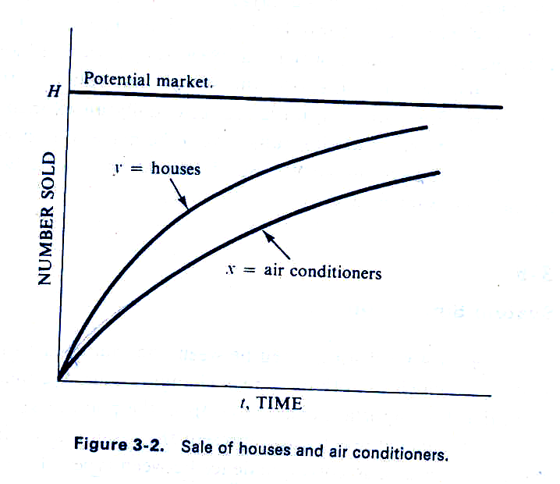

Slide 8
The horizontal line at H is the total potential market for houses. The curve for y indicates how the number of houses sold increases with time. The slope of the curve (i.e., the rate at which y increases) decreases as H - Y gets less. This reflects the slowdown of sales as the market becomes saturated. Mathematically, the trend can be expressed by the equation ­
y = k1 ( H – y ), where y = 0 at t = o

Slide 9
Consider now a manufacturer of central air conditioners designed for houses. His rate of sales depends upon the number of houses built. (For simplicity, it is assumed that all houses will install an air conditioner.) As with house sales, the rate of sales diminishes as the unfilled market diminishes.
Let x be the number of installed air conditioners. Then the unfilled market is the difference between the number of houses and the number of installed air conditioners. The sales trend may be expressed mathematically by the equation
x = k2 ( y - x ), where x = 0 at t = o

Slide 10
The change of x with time is also illustrated in above fig. The two equations constitute a model of the growth of air conditioner sales. Because of its simplicity, it is in fact possible to solve the model analytically. However, it quickly becomes insoluble. if it is expanded to become more representative of actual marketing conditions.
The market limit, for example, may not be stable. It could grow with population growth or fluctuate with economic conditions. The coefficients that determine the rates of growth could be influenced by the amount of money spent on advertising, and there could be competitive influences, such as mobile homes or apartment housing. These influences could also depend upon the population growth or prevailing economic conditions, and so further complicate the model.

Slide 11
The simple model, however, will serve to illustrate the general methods applied in continuous simulation. The simulation technique is to compute the output, step by step. Suppose that the computation is made at uniform intervals of time and that the calculation has already progressed to the time t, when the two variables of the problem have the values Yi and Xi Figure below shows the next step in the calculation.
The calculation steps forward an interval Δt to ti+1 = ti + Δt . The rates of sales are assumed to be constant over the interval.

Slide 12
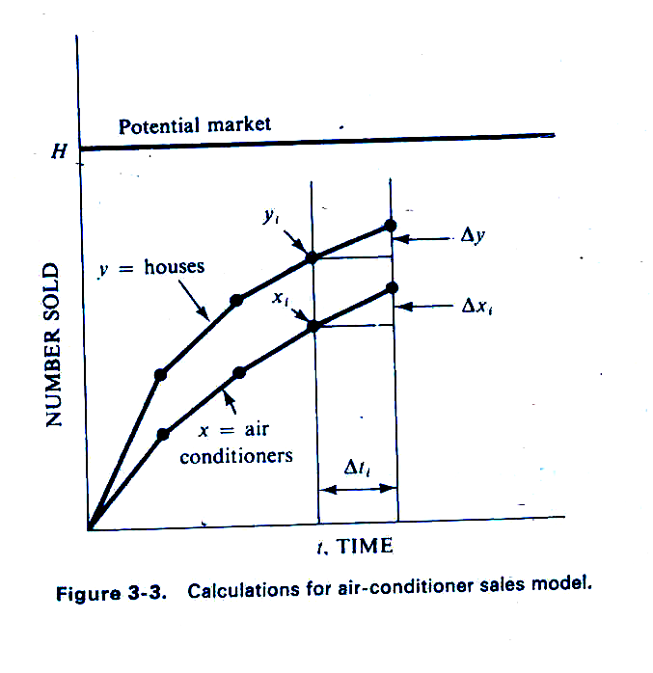

Slide 13
The rates can be interpreted as the amount of change per unit time. That is,
rate of change of y = Δyi / Δt
rate of change of x = Δxi / Δt
From the. equations of the model, these may be written
Δyi = k1(H - Yi) Δt Δxi = k2(Yi - xi) Δt
Since Yi and Xi are known, it is a simple matter to get the values of Y and x at time ti+1. However, it will be noticed that the equation for Δyi must be solved first to get the value of yi needed in the equation for Xi. In preparation for the solution of a continuous system model, therefore, there must be a careful sorting of the equations to establish a workable order.

Slide 14
Repetition of the calculation using the new values of Y and X produces the output at the end of the n.ext interval. As illustrated in above fig, the calculation is equivalent to calculating the slope at each point and projecting a short straight line at that slope. The simulation output is a series of such line segments, approximating the continuous curve that represents the true output of the model.
There are many programming systems available that incorporate continuous system simulation languages. They usually include a number of computational methods for the user's selection.

Slide 15
Numerical Computation Technique for Discrete Models :
To illustrate the general computational technique of simulation with discrete models, consider the following example. A clerk begins his day’s work with a pile of documents to be processed. The time taken to process them varies. He works through the pile, beginning each document as soon as he finishes the previous one, except that he takes a five minute break if, at the time he finishes a document, it is an hour or more since he began work or since he last had a break.
We assume the times to process the documents are given. We will also keep a count of how many documents are left. The count will be initially set to the number of documents at the beginning of the day, and, in this simple model, we will assume that no documents arrive during the day. The count will be decremented for each completed job, and work will stop if the count goes to zero.

Slide 16
The computations involved can be organized as shown in Table below. The ith row corresponds to the ith document. The first column numbers the documents.
Document Number, i | Start Time, tb | Work Time, tw | Finish Time, tf | Cumul. Time, tc | Break Flag, F | Number of jobs, N
1 | 0 | 45 | 45 | 45 | 0 | 57
2 | 45 | 16 | 61 | 61 | 1 | 56
3 | 66 | 5 | 71 | 5 | 0 | 55
4 | 71 | 29 | 100 | 34 | 0 | 54
5 | 100 | 33 | 133 | 67 | 1 | 53
6 | 138 | 25 | 163 | 25 | 0 | 52
7 | 163 | 21 | 184 | 46 | 0 | 51

Slide 17
There are are then four columns giving various times, measured in minutes from time zero.
The second column gives the time the clerk begins to work on a document, denoted by tb(i).
The third column gives the time required to work on the document, denoted by tw(i),
and the fourth column gives the time each document is finished.
The fifth column contains the cumulative time since work started or since the last break, measured at the time each job is completed. This is denoted by tc(i).
There is a sixth column which contains a flag, denoted by F, that takes the value 1 if the clerk should take a break after the ith document, and the value 0 if he should not.
The clerk works until there are no more documents, or the time he finishes a document goes beyond some time limit.

Slide 18
The computation proceeds row by row, and from left to right. The first row shows that work starts on the first document at time zero. The processing time is 45 minutes, so the job is finished at 45, with a cumulative time ( in this case, since the start of work ) of 45. This is not long enough for a break, so the flag is set to 0. The count, which was initialized to 57 jobs is dropped to 56.
Because the flag is zero and the count is not zero, the second document is begun at 45. It needs 16 minutes for processing, which leads to a cumulative time of 61, so the flag is set to 1 to indicate that a break should be taken. Because of the five minute break, the third document starts at 66. The computation continues in this manner until either, N, the count of documents to be processed, drops to zero, or the finish time, tf, reaches some limit representing the end of the work period.

